Slide 1
CSYE 6200 - DayCare
Team members
Vedant Deokar
Tianxiang Ren
Zibin Kang
Shakti Rao
Xuhui Zhu
Yucong Feng

Slide 2
Introduction
The application intended to solve the problem of day care for children.
It assigns students to teachers and student and teachers to classrooms based on ClassroomRules.
Defines vaccines needed to be taken based on age groups.
Can Create Students, Teachers and Vaccine records.
Implements Annual Registration Renewal for students.
Tracks Immunization Records for students
Tracks annual student registration
Send email notification to parents as a reminder

Slide 3
Installation and operating instructions
Download and Install Apache NetBean 12.x
Clone the Project from GitHub
Open the Project in NetBeans
Run the project

Slide 4
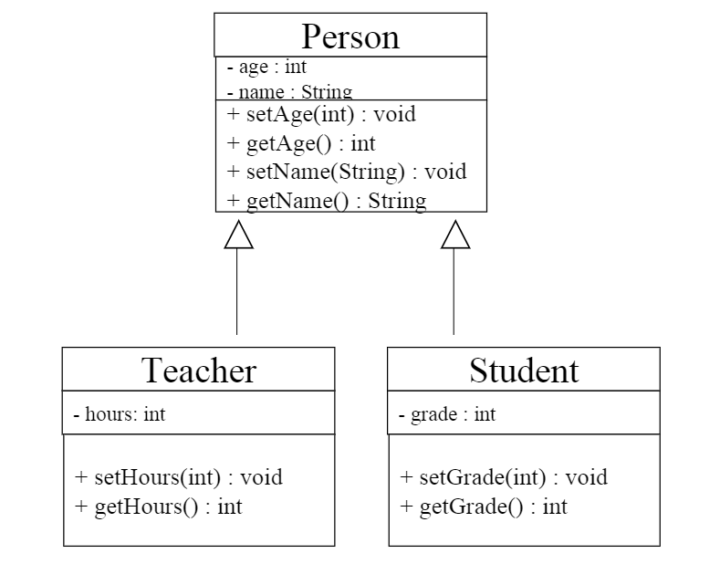
UML
What is UML?
A UML diagram is a diagram based on the UML (Unified Modeling Language) with the purpose of visually representing a system along with its main actors, roles, actions, artifacts or classes, in order to better understand, alter, maintain, or document information about the system.
e.g A person class diagram :

Slide 5
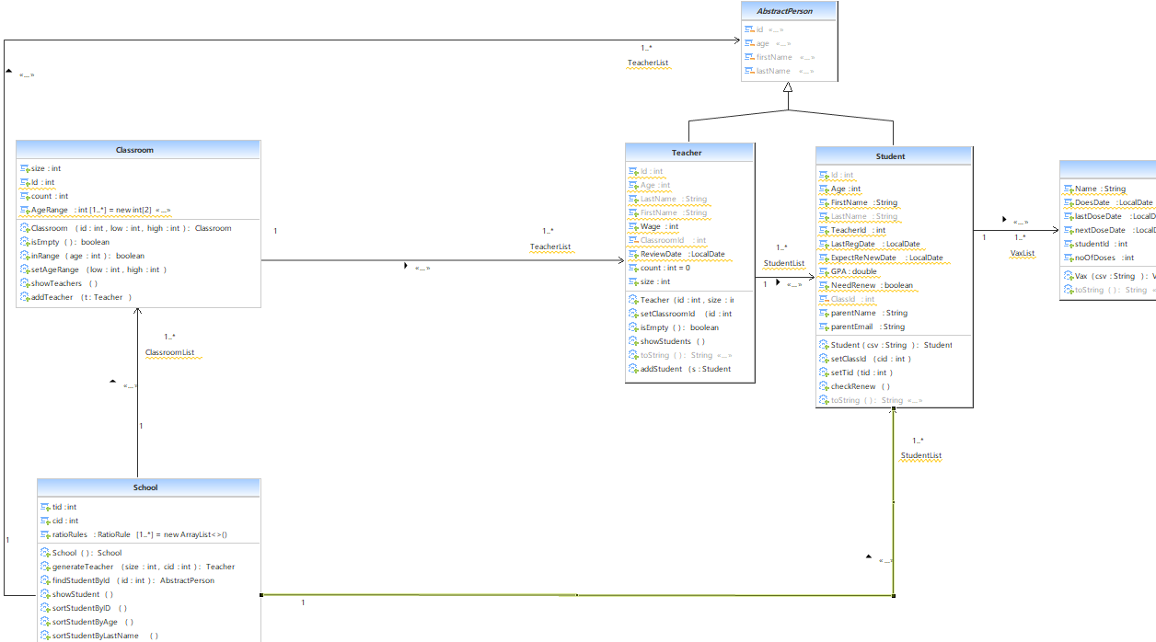
UML Diagram in our project

Slide 6
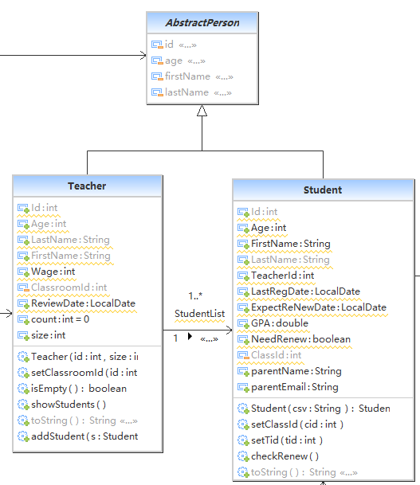
AbstractPerson Diagram

Slide 7
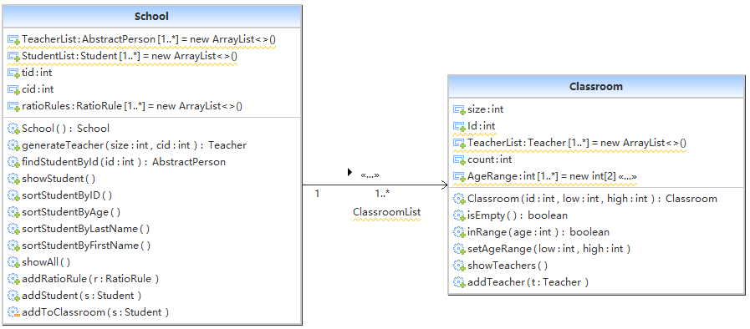
Class Diagram

Slide 8
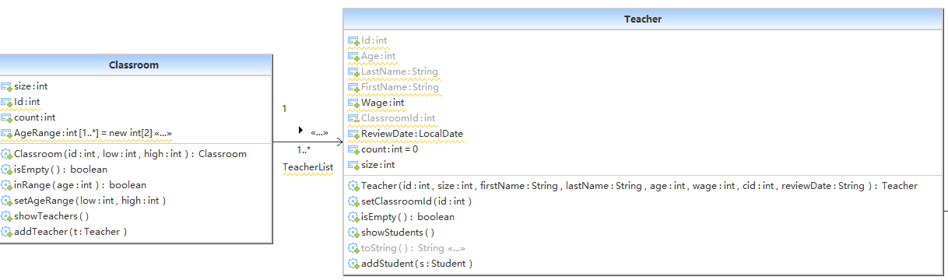
Class Diagram

Slide 9
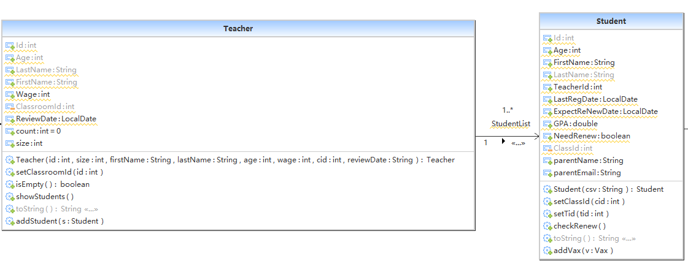
Class Diagram

Slide 10
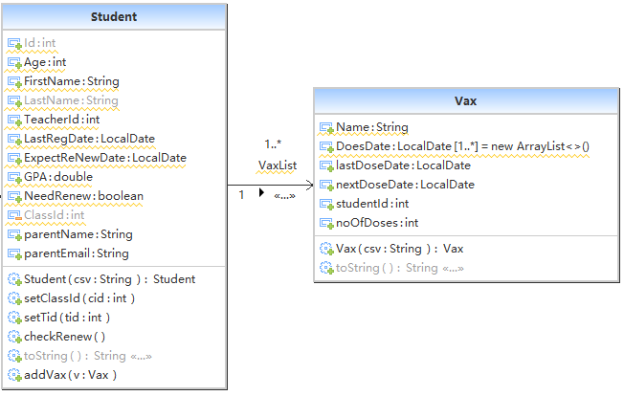
Class Diagram

Slide 11
Design Patterns
Factory Method Pattern and Singleton pattern
MVC
S.O.L.I.D

Slide 12
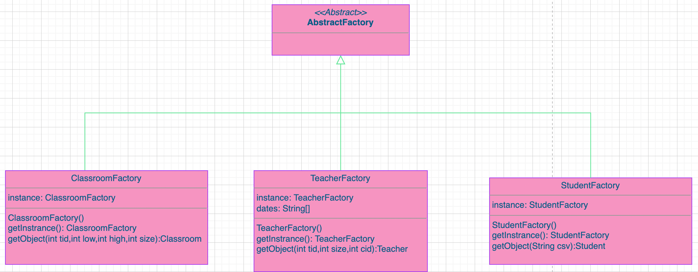
Design Pattern -1
Factory Method Pattern
We have 3 concrete factory subclasses derived from an AbstractFactory super class, These three classes are ClassroomFactory, StudentFactory and TeacherFactory. All use singleton pattern.

Slide 13
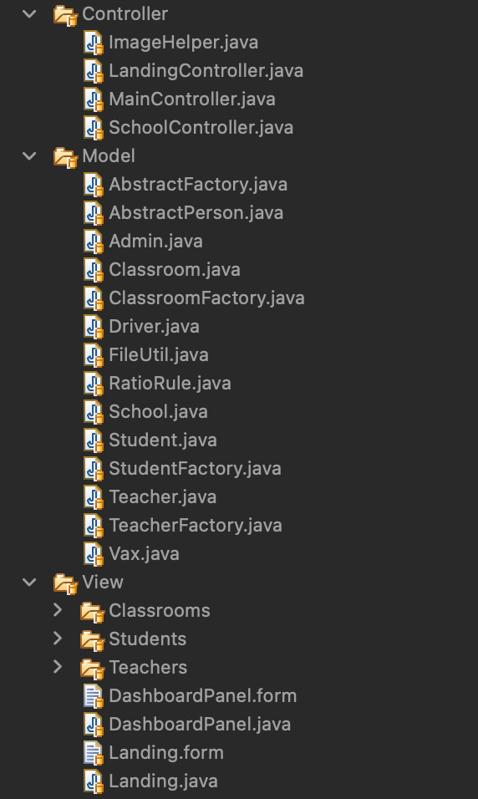
Design Pattern -2
Model View Controller Design Pattern
Benefit for using MVC :
Faster Development Process
Easy Planning and maintenance
Multiple Views
Separation of concerns

Slide 14
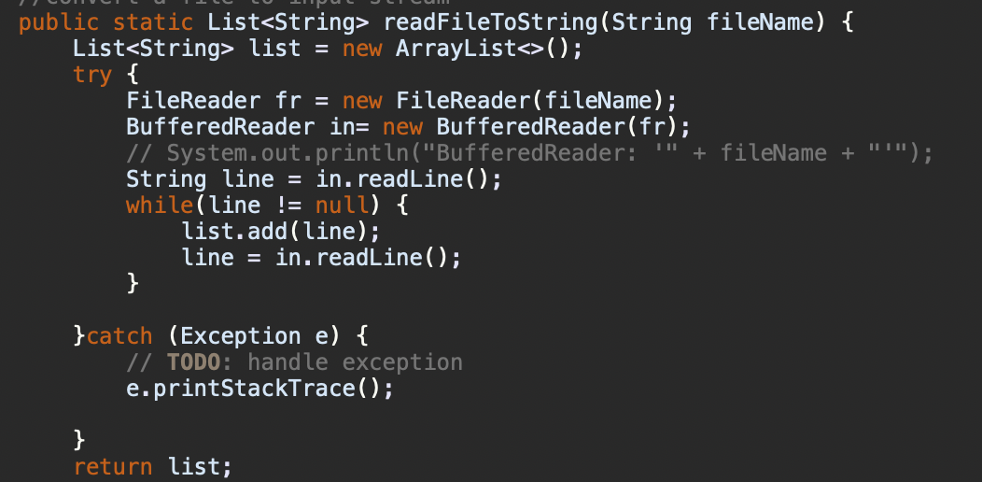
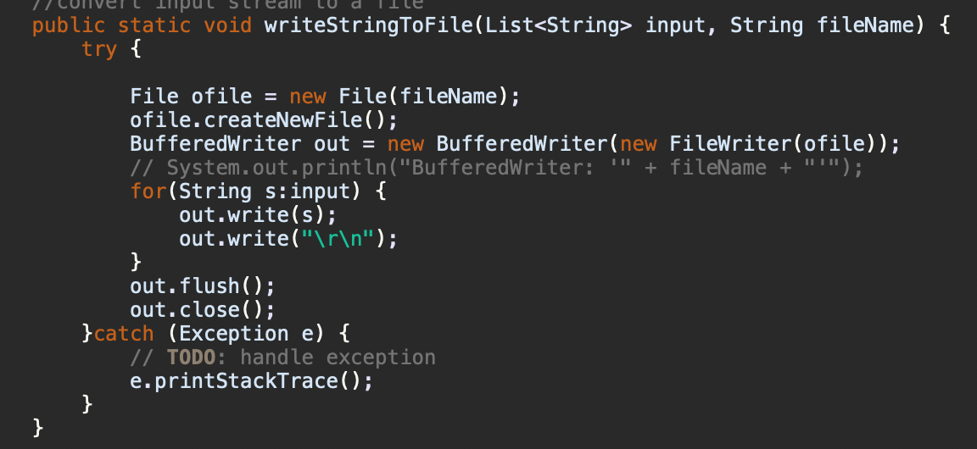
CSV File I/O
ReadFile Function
WriteStringToFile Function

Slide 15
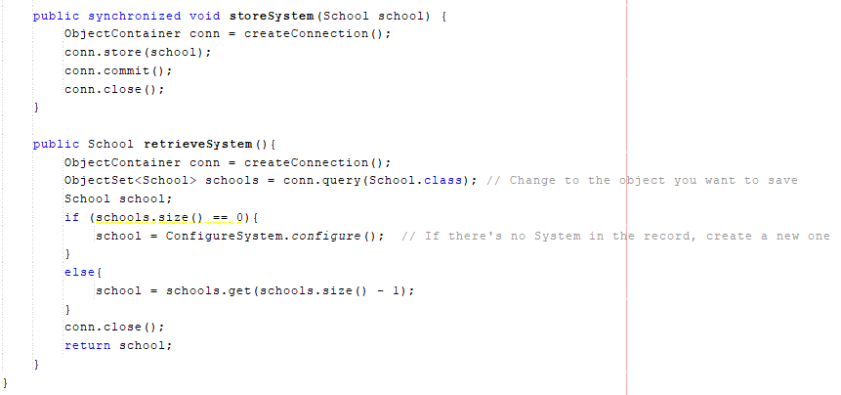
Db4o data persistence
Embeddable open-source object database.

Slide 16

Object Oriented Principles
We have used all four Principles to design our code
Inheritance: Inheritance is always applied
Polymorphism : we have override toString() Function
Encapsulation: we apply encapsulation over and over again in our code , for example:
Abstraction: we have two abstract class , AbstractPerson class and AbstractFactory class

Slide 17
S.O.L.I.D
Single Responsibility Principle: All data (supporting purpose) class private and supply public API (supporting purpose)
Liskov Substitution Principle: Any subclass may be Substituted for its Super class.
Interface Segregation Principle: No class depends on any method it does not use.

Slide 18
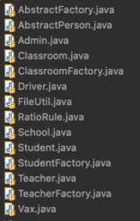
Component & Subsystem Description
AbstractFactory.java /ClassroomFactory.java /StudentFactory.java /TeacherFactory.java: There are 3 concrete Factory subclasses(ClassroomFactory, StudentFactory and TeacherFactory) derived from an facotry Abstract super class(AbstractFactory).
AbstractPerson.java: Sets Abstract functions for subclasses(Teacher class and Student class).
Student.java /Teacher.java /School.java /Classroom.java: Holds all data and set attributes of these 4 classes. For example(School.java), when a new Student is added to school, it will be automatically assigned with a teahcer and be added to a Classroom.
FileUtil.java: Includes the function of reading from and writing on a CSV file.
RatioRule.java:Adds Classroomid to Teacher, and add maximum groups per classroom to CSV.
Vax.java: Holds all data and set attributes for vaccine information and split the data from CSV.

Slide 19

Subsystems interaction
manipulate model and return data
GUI
Controllers
Listeners
Models
retrieve
& store
class objects
Load initial data
Db4o
Starter CSV files

Slide 20

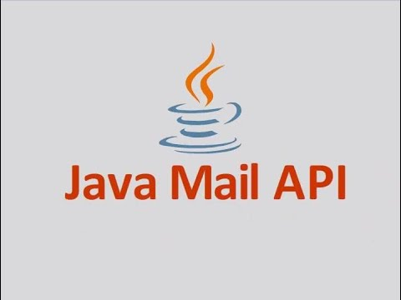
External libraries, packages and technologies
JFreeChart - plot Pie chart
javax-mail-api - sending email notifications
Javafaker - generate dummy data

Slide 21
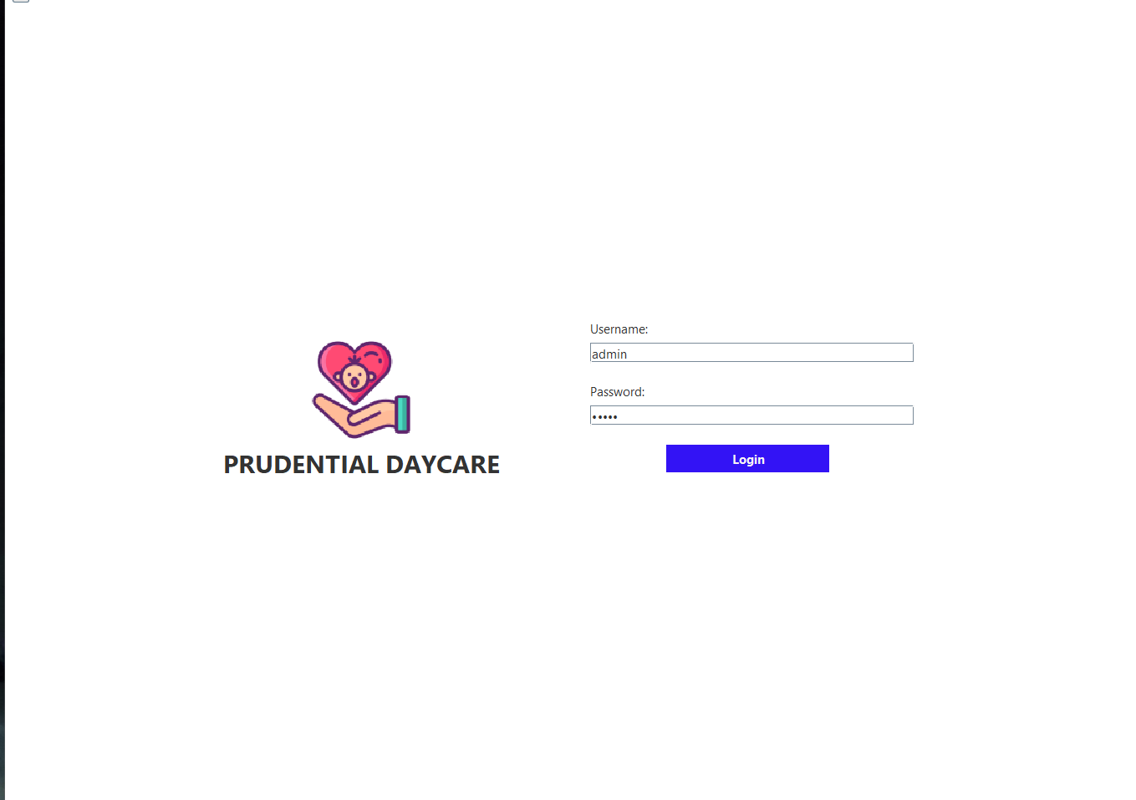
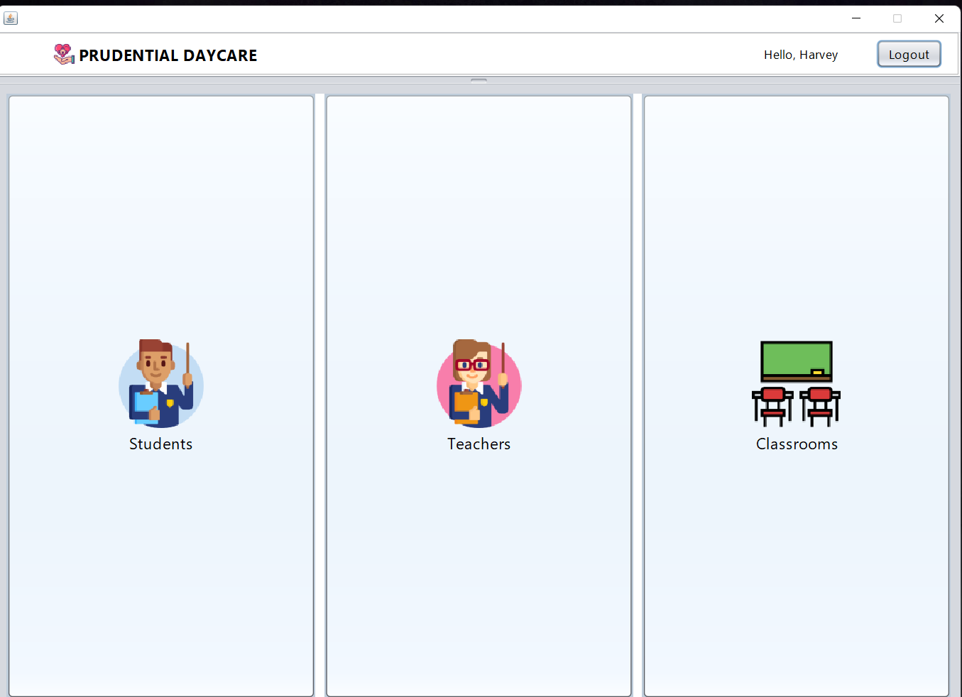
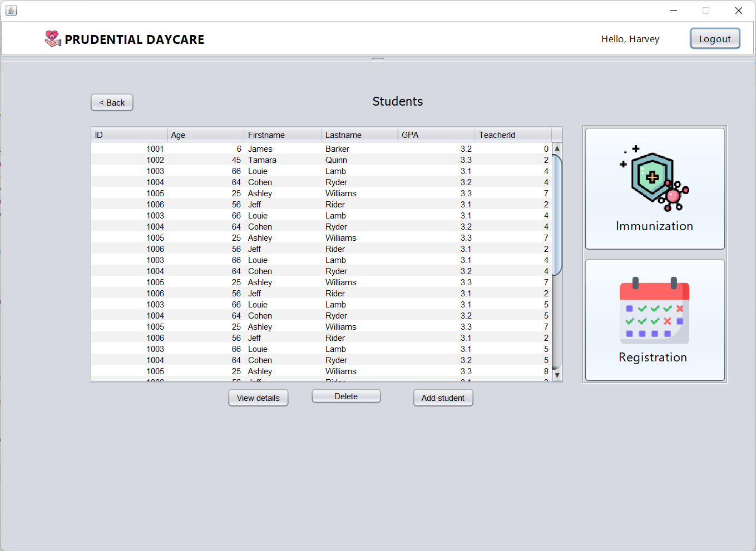
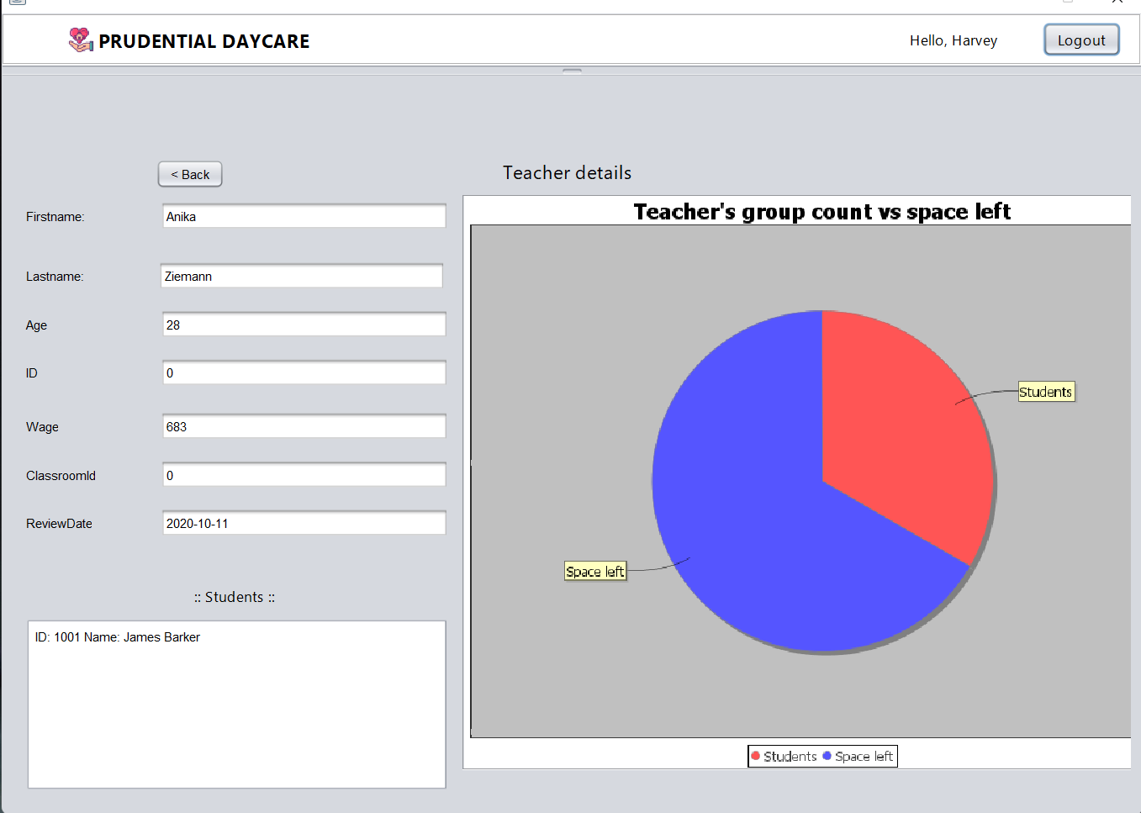
Screenshots

Slide 22
Project contributors and list of their work
Xuhui Zhu: School, Classroom,Teacher and Student Class design, implements algorithm for adding Students and assign them to empty Classroom/Group.
Tianxiang Ren: File IO System. Create CSV file and test.
Yucong Feng: Factory Classes. Implements Date tracking for Student and Teacher.
Zibing Kang: Vax Class. Implements Vax record tracking for Student.
Vedant Deokar: Email notification API, JFreeChart, Swing GUI implementation, Db4o database for persistence

Slide 23
Future improvements
Use a relational database like SQL to store all data
Add more operations on Teacher
Use a messaging API like Twilio to remind parents/employees about upcoming events
Download CSV from the table (GUI)

Slide 24
Thank you!

